Slide 1
Topic 1.1 Linux Evolution and Popular Operating Systems
C851 Cohort Live Session for Sunday, November 21, 2021
Dr. John S. Galliano | C851 Linux Foundations Instructor

Slide 2
Agenda
Welcome
About the Exam
The 5 Exam Domains
Lecture
Demos
Sample Exam Questions
Wrap-Up

Slide 3

About the Linux Essentials v1.6 [1]
The 5 Exam Domains [3]
No prerequisites
Closed book, up to 60 minutes
40 multiple-choice (some multi-select and fill-in-the-blank items) questions
Min pass score 500 points (200-800 scale)
Partially correct responses not accepted (for F-I-T-B questions LPI may accept multiple correct versions of an answer [2]
Total exam weight count is 40, thus 40 questions
The Linux Community and a Career in Open Source
Finding Your Way on a Linux System
The Power of the Command Line
The Linux Operating System
Security and File Permissions
[1,3] Linux Professional Institute, “Linux Professional Institute Linux Essentials,” Linux Professional Institute, 21-Oct-2018. [Online]. Available: https://www.lpi.org/our-certifications/linux-essentials-overview. [Accessed: 14-Aug-2021]
[2] Dr. Galliano’s correspondence with LPI, dated August 2021: Example: with/without leading path in a case where the answer is a command
Notes:
Examples:
• If an objective has a weight of 3, there will be 3 questions on the exam related to that objective [2]
Links:
• View the 3rd party cert tips video at https://bit.ly/3party_cert_tips
• https://explainshell.com/ to learn about commands, options, arguments
• Dr. Galliano’s Github repo (study guide, cheatsheets, slidedecks, etc. at https://github.com/g33k247/851

Slide 4

LPI Exam Re-Take Policy [4]
Anyone who takes an LPI exam once must wait one week before re-taking
Anyone who takes an LPI exam a second (and subsequent) time must wait 30 days before re-taking
3rd and subsequent attempts at your own cost ($120)
[4] Linux Professional Institute, “Privacy Statement and Policies,” Linux Professional Institute, 18-May-2018. [Online]. Available: https://www.lpi.org/policies. [Accessed: 14-Aug-2021].
Notes:
• Anyone who passes an LPI exam may not retake that exam for two years

Slide 5

Exam Topics/Weightings
Linux Essentials v1.6 Exam Topics [5] | 1.1 | 2
 | 1.2 | 2
 | 1.3 | 1
 | 1.4 | 2
 | 2.1 | 3
 | 2.2 | 2
 | 2.3 | 2
 | 2.4 | 2
 | 3.1 | 2
 | 3.2 | 3
 | 3.3 | 4
 | 4.1 | 1
 | 4.2 | 2
 | 4.3 | 3
 | 4.4 | 2
 | 5.1 | 2
 | 5.2 | 2
 | 5.3 | 2
 | 5.4 | 1
 |  | 40
[5] Linux Professional Institute, “Linux Essentials Objectives V1.6 - LPI Wiki,” Linux Professional Institute, 25-Jan-2020. [Online]. Available: https://wiki.lpi.org/wiki/Linux_Essentials_Objectives_V1.6. [Accessed: 14-Aug-2021].
Notes:
• A weight of “1” equates to 1 exam question
• Since there is a weight of ‘1’, you will see 1 question on this topic!

Slide 6

1.1 Linux Evolution and Popular Operating Systems [6]
Weight: 2 (2 questions)
Description:
Knowledge of Linux development and major distros
Key Knowledge Areas:
Distributions
Embedded Systems
Linux in the Cloud
Files used, terms and utilities:
Debian, Ubuntu (LTS), CentOS, openSUSE, Red Hat, SUSE, Linux Mint, Scientific Linux, Raspberry Pi, Raspbian, Android
[6] Linux Professional Institute (LPI), “Exam 010 Objectives,” Linux Professional Institute, 21-Oct-2018. [Online]. Available: https://www.lpi.org/our-certifications/exam-010-objectives. [Accessed: 10-Jul-2021].

Slide 7
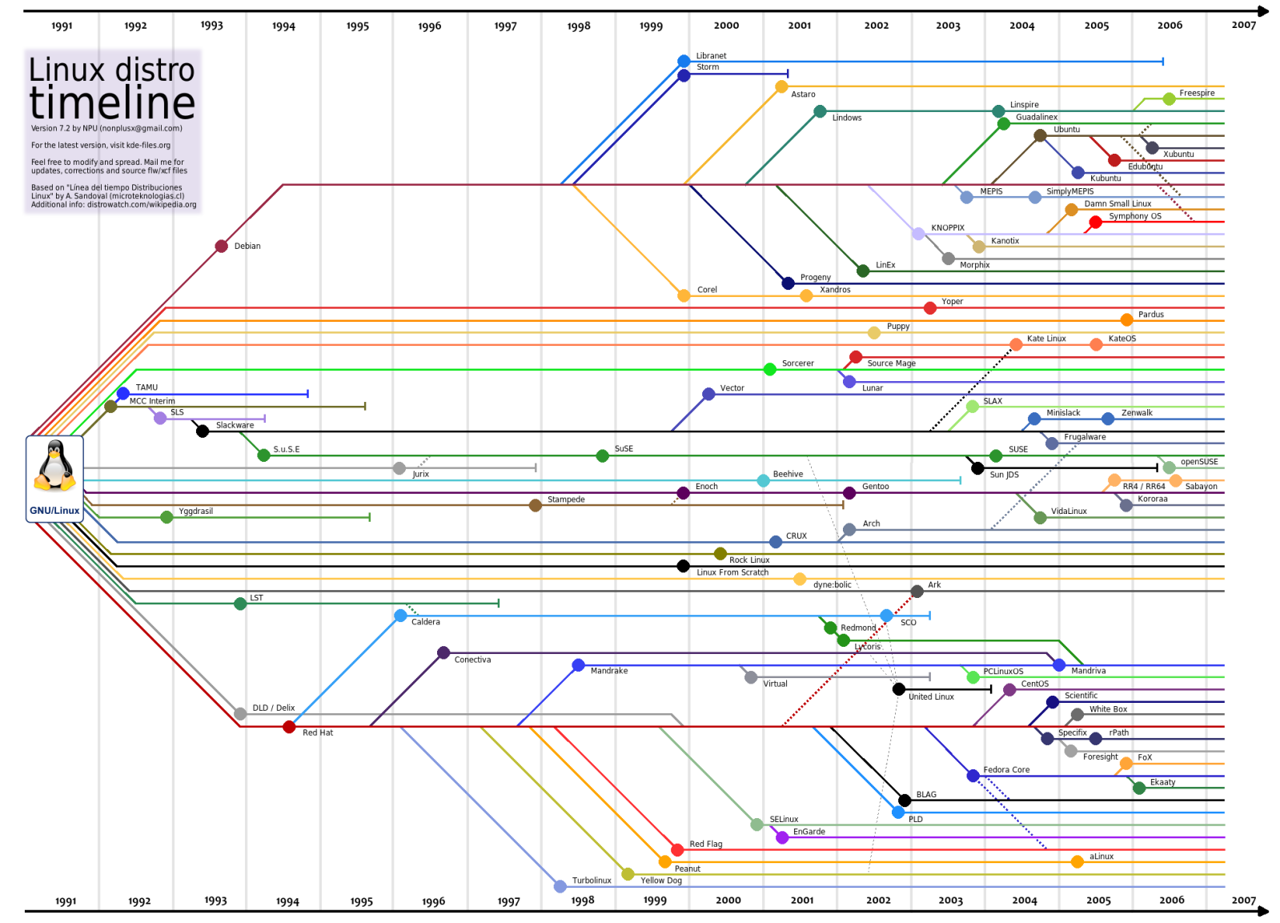
1.1 Linux Evolution and Popular Operating Systems
DEBIAN
SLACKWARE
ARCH
RED HAT
[8] A. Lundqvist, D. Rodic, M. Mustafa, M. Herdiansyah, and F. Loli, “GNU/Linux Distributions Timeline v20.10,” Wikipedia, 25-Oct-2020. [Online]. Available: https://upload.wikimedia.org/wikipedia/commons/1/1b/Linux_Distribution_Timeline.svg. [Accessed: 14-Aug-2021].

Slide 8
Linux Distributions [7]
Bundle 3 components:
The Linux kernel
GNU system utilities
Other software applications
Maintained by a company or user community
Purpose specific & Family oriented
Lifecycles
Family | Distros
Debian | Debian, Mint, Ubuntu (LTS)
Red Hat | Red Hat, CentOS, Oracle Linux, Scientific Linux, Fedora
Slackware | openSUSE, SUSE
Note: Underlining indicates Enterprise-grade
Considerations: cost, performance, scalability, stability, and hardware demand of the system
[7] C. Bresnahan and R. Blum, “LPI Linux Essentials Study Guide: Exam 010 v1.6.,” John Wiley & Sons, Incorporated, 2020. Chapter 12 [Online]. Available: https://ebookcentral.proquest.com/lib/westerngovernors-ebooks/reader.action?docID=6002518. [Accessed: 23-Oct-2021].

Slide 9

Embedded Linux Systems [7]
• Hardware/software designed to function as part of a larger system
• Typically used to control other devices
• Automotive, home, medical, and smart devices
• Run on a Linux kernel-based operating system
• Examples:
Android used on mobile phones
Raspbian used on the Raspberry Pi
Notes:
The major advantages of Linux over any proprietary embedded software include cross vendor platform compatibility, development, support and no license fees.

Slide 10
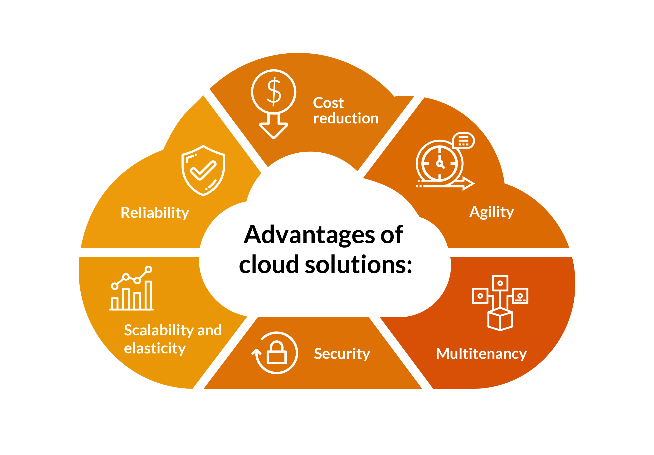
Linux in the Cloud [7]
Linux offered as part of Infrastructure as a Service (IaaS)
IaaS instances are virtual machines that are provisioned within minutes in the cloud
Cloud providers offer various images containing ready to run many Linux distros
“As of 2017, Linux was running 90 percent of the public cloud workload.” [8]
[7] C. Bresnahan and R. Blum, “LPI Linux Essentials Study Guide: Exam 010 v1.6.,” John Wiley & Sons, Incorporated, 2020. Chapter 12 [Online]. Available: https://ebookcentral.proquest.com/lib/westerngovernors-ebooks/reader.action?docID=6002518. [Accessed: 23-Oct-2021].
[8] CBTnuggets, “Why Linux Runs 90 Percent Of The Public Cloud Workload,” CBT Nuggets Blog, 10-Aug-2018. [Online]. Available: https://www.cbtnuggets.com/blog/certifications/open-source/why-linux-runs-90-percent-of-the-public-cloud-workload. [Accessed: 21-Nov-2021].
Notes:
Notes:

Slide 11

Demos
Based on Red Hat Enterprise Linux (RHEL)
Oracle Linux is an open-source clone
Did You Know? Oracle’s Linux distro is a clone of RHEL and used in the Oracle Cloud Infrastructure (OCI).
Notes:
• Distro Watch: https://www.distrowatch.com
• Distro Test: https://distrotest.net
• AWS: https://aws.amazon.com

Slide 12


Exam Practice Questions
Join at slido.com # 039723
ⓘ Start presenting to display the joining instructions on this slide.

Slide 13

Notes:
Interested?
• Contact the email address or connect via social media links at the bottom of the graphic
• Mention that you were referred by Dr. Galliano.

Slide 14
What Questions Do you Have for Me?

